Slide 1
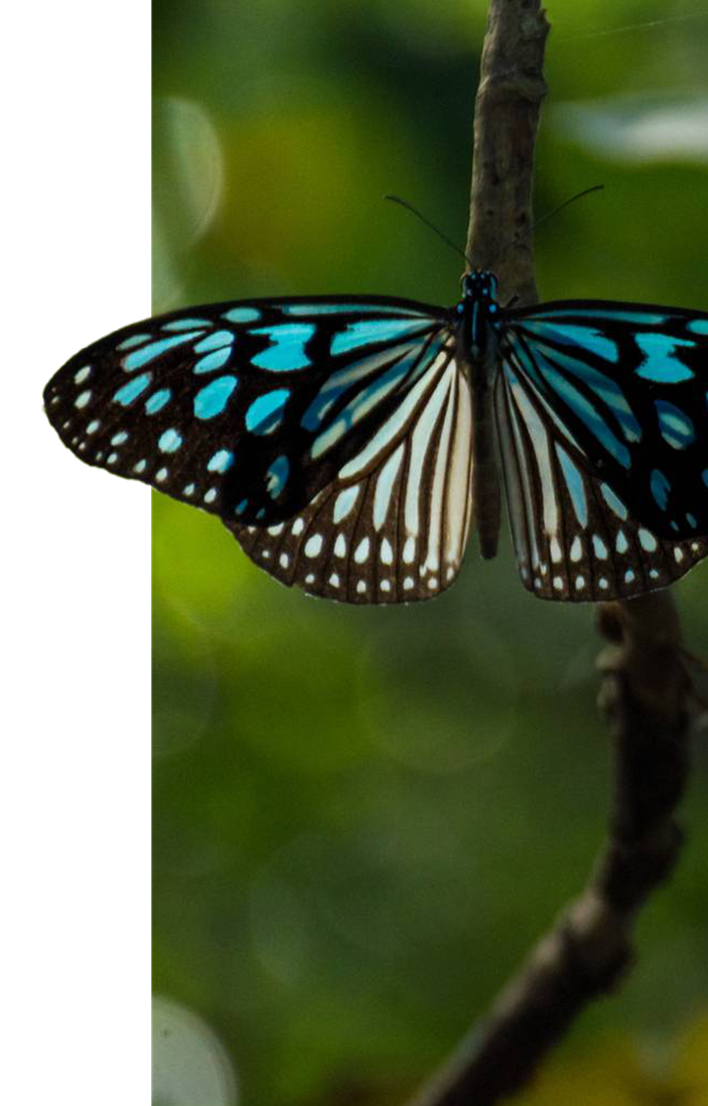

Evaluating PMI estimation accuracy using dna degradation patterns in necrophagous insects
Cathryne Smith, M.S.
Oklahoma State University Center for Health Sciences
November 2025

Slide 2
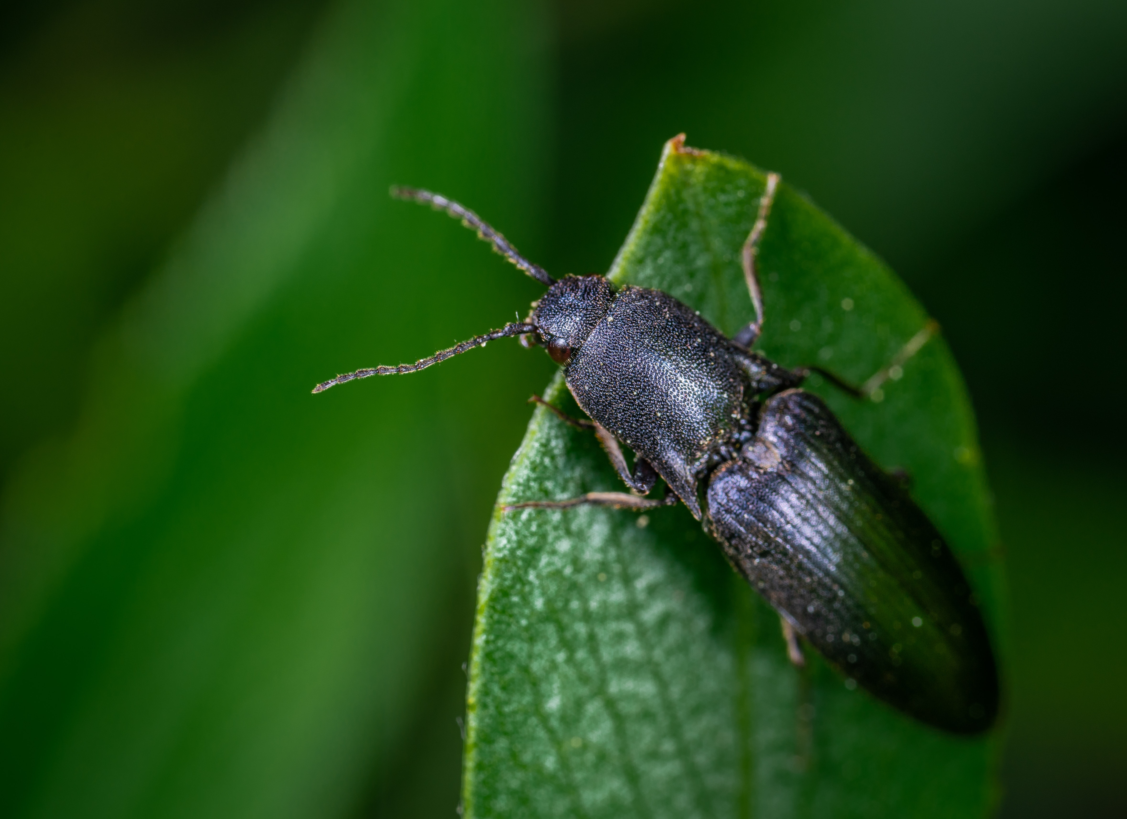
Purpose
To evaluate whether species, developmental stage, and environmental exposure influence insect DNA degradation, and whether molecular degradation markers (DNA concentration, STR completeness) improve PMI estimation accuracy.

Slide 3
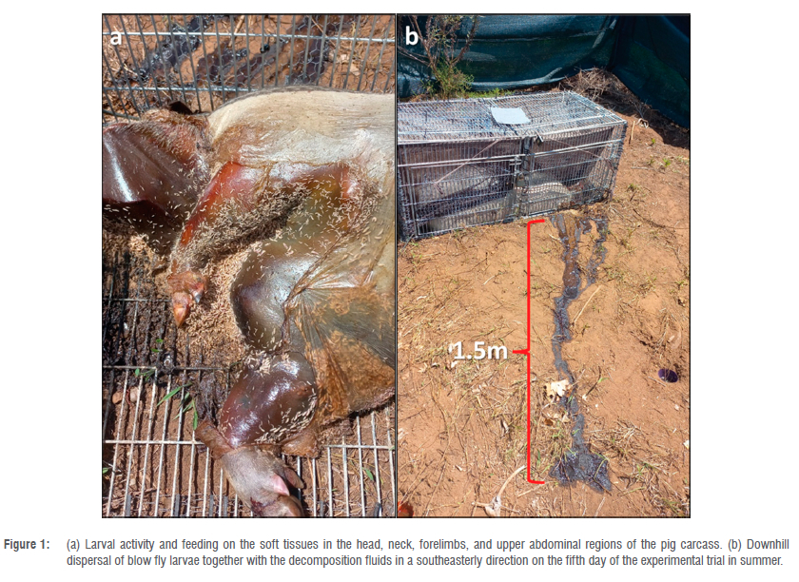
Research Questions & Hypotheses
Do species, developmental stage, and environmental exposure influence DNA degradation patterns in necrophagous insects, and do molecular degradation metrics (DNA concentration and STR completeness) improve the accuracy of PMI estimation?
H1: DNA degradation patterns differ significantly by species, developmental stage, and environmental exposure, and molecular degradation variables (DNA concentration and STR completeness) significantly improve PMI estimation accuracy.
H0: DNA degradation patterns do not differ significantly across species, developmental stage, or environmental exposure, and molecular degradation variables do not improve PMI estimation accuracy.
This Photo by Unknown Author is licensed under CC BY

Slide 4
Variables and Measurement Levels
N = 240
Balanced design: 4 x 3 x 2 (10 insects per cell/group)
Variable | Type | Level
Species (4) | IV | Nominal
Stage (3) | IV | Ordinal
Environment (2) | IV | Binary Nominal
DNA concentration (ng/µL) | DV | Ratio
STR completeness (%) | DV | Ratio
PMI error (hours) | DV | Ratio

Slide 5
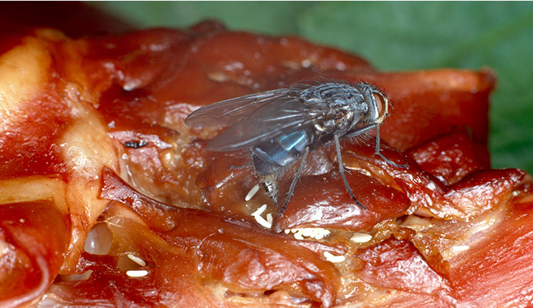
Statistical Methods
Primary Analysis: MANOVA
Three-factor MANOVA
DVS: DNA concentration, STR completeness, PMI Error
IVs: Species, Stage, Environment
Copyright: © The Trustees of the Natural History Museum, London
Secondary Analysis: Hierarchical Regression
Block 1: Species, Stage, Environment
Block 2: DNA concentration, STR completeness
Purpose: to determine if molecular variables add predictive power for PMI error

Slide 6
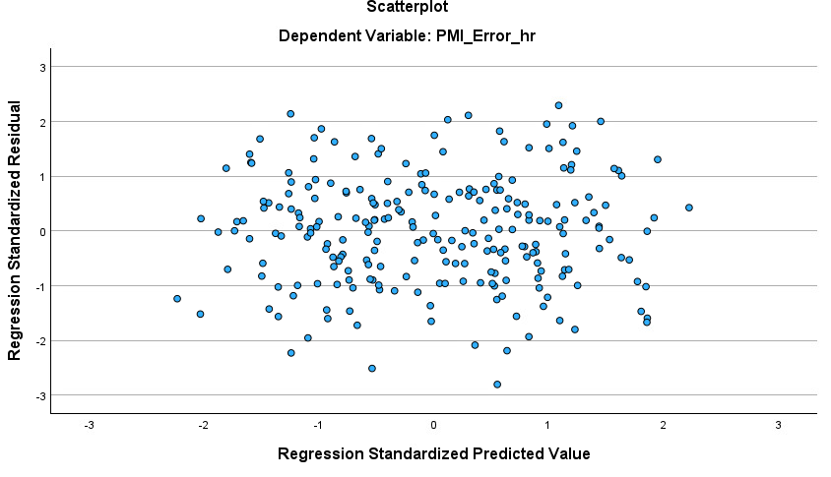
Assumption Testing
MANOVA:
Box’s M Test:
Box’s M = 143.95
P = 0.777 Covariance matrices equal
Levene’s Tests:
DNA: p = 0.273
STR: p = 0.807
PMI: p= 0.111
Homogeneity of variance met
Multivariate Normality:
Symmetric distributions
Balanced design
Assumptions satisfied
Figure 1. Standardized residuals vs. predicted values, showing homoscedasticity (constant variance) in the regression model.

Slide 7
Descriptive Statistics
Overall Descriptive Statistics
DV | Mean | SD
DNA concentration | 106.38 ng/µL | 31.94
STR completeness | 54.38% | 18.26
PMI error | 25.11 hr | 5.46
Factor-Level Summary
Factor | Level | DNA M | STR M | PMI M
Species | Lucilia | 81.2 | 40.1 | 29.3
 | Calliphora | 84.5 | 42.7 | 28.6
 | Dermestes | 122.8 | 64.3 | 22.4
 | Necrobia | 130.1 | 70.9 | 20.9
Stage | Larva | 89.3 | 44.6 | 28.1
 | Pupa | 108.5 | 54.9 | 24.2
 | Adult | 121.3 | 62.4 | 22.3
Environment | Shade | 121.5 | 62.2 | 22.0
 | Exposed | 91.3 | 46.4 | 28.2

Slide 8
MANOVA Results
Multivariate Tests (Pillai’s Trace)
Effect | Pillai’s Trace | F | p
Species | 0.882 | 47.12 | < .001
Stage | 0.691 | 30.51 | < .001
Environment | 0.533 | 58.19 | < .001
Species × Stage | 0.112 | 1.31 | .168
Species × Environment | 0.074 | 1.92 | .069
Stage × Environment | 0.046 | 1.76 | .107
3-way Interaction | 0.032 | 0.84 | .648
All main effects significant Strong, additive biological and environmental influences.
No interactions effects are independent, no synergistic.

Slide 9
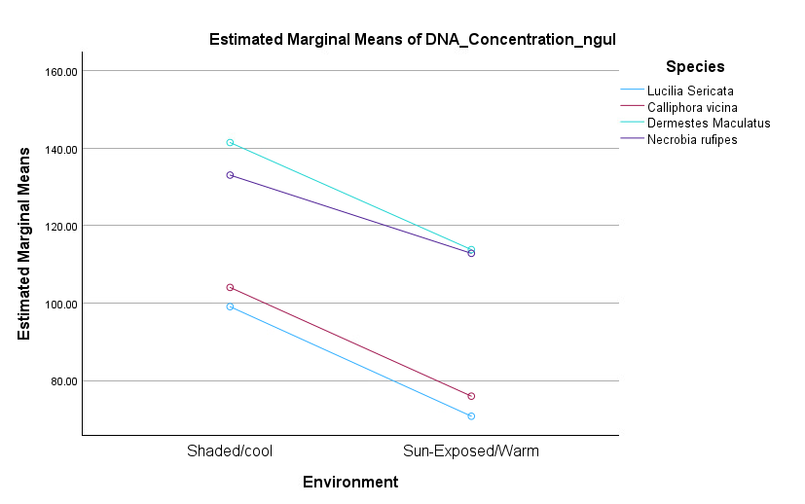
Post Hoc Comparisons
Developmental Stage (Bonferroni)
Adult > Pupa (p< .001)
Adult > Larva (p< .001)
Pupa > Larva (p= .004)
Environment (Bonferroni)
Shaded > Exposed for all DVs – p <.001
Figure 1. Estimated marginal means of DNA concentration (ng/µL) across shaded/cool vs. sun-exposed/warm environments for each insect species. Higher concentrations in the shaded condition indicate reduced DNA degradation.
Species (Bonferroni)
Beetles (Dermestes, Necrobia) > Blowflies (Lucilia, Calliphora) – all p<.001

Slide 10
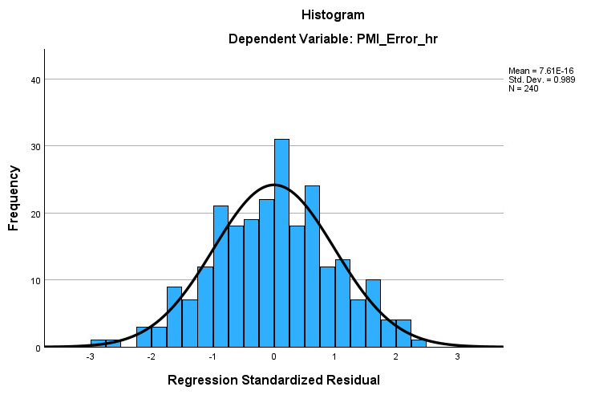
Hierarchical Regression Results
Block 1 (Species, Stage, Environment)
R = .575
R² = .331
Biological factors explain 33.1% of PMI error
Block 2 (DNA concentration, STR completeness)
R = .687
R² = .472
ΔR² = .141, p <.001
Molecular markers improve PMI prediction significantly
Key Predictors (Block 2)
DNA concentration: β = -.369, p < .001
STR completeness: β = - .318, p < .001
Higher molecular integrity Lower PMI error
Figure 1. Distribution of Regression Standardized Residuals (PMI_Error_hr).
The histogram demonstrates that residuals follow an approximately normal distribution, supporting the regression assumption of normality.

Slide 11
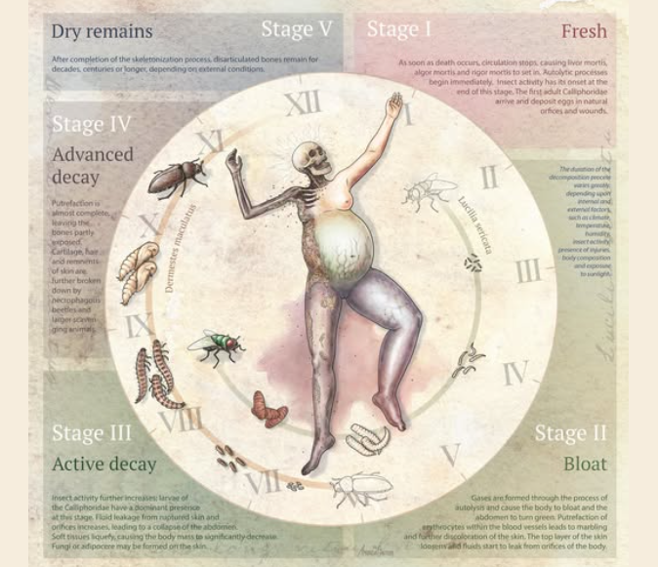
Interpretation & Implications
Biological Findings
Beetles preserve DNA better than blowflies
Adults > Pupae > Larvae
Shade preserves DNA better than exposed environments
Molecular Findings
DNA concentration & STR completeness strongly predict PMI error
Molecular degradation curves could augment PMI estimation
Operational Implications
Use DNA integrity as a supplemental PMI metric
Useful for ambiguous life stages or degraded specimens
Applicable to crime labs utilizing existing STR kits
Image by Gautier Scientific Illustration

Slide 12
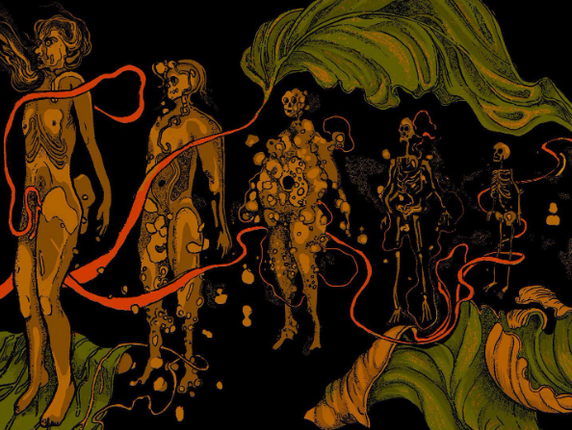
Conclusion
Species, stage, and environment significantly affect DNA degradation.
Molecular degradation variables significantly improve PMI prediction.
Results support future development of insect molecular PMI estimation models.
Future Research:
Apply to empirical insect samples
Expand environments & taxa
Develop insect-specific STR/SNP panels
5 Stages of Human Decomposition by Evaredamonti Art

